Slide 1
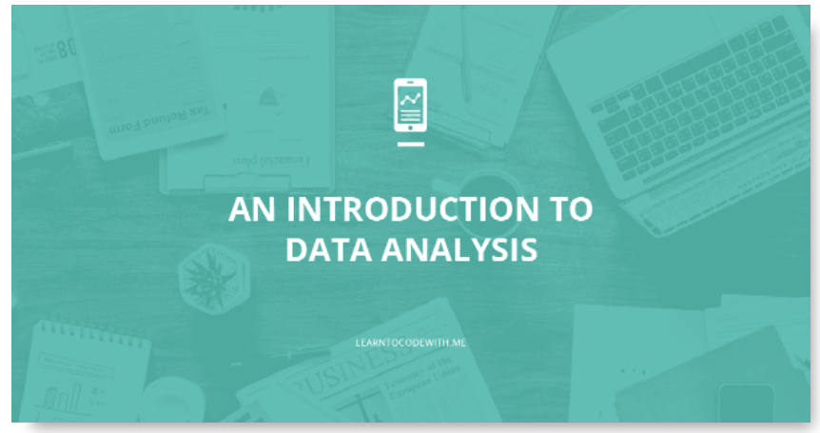
Introduction to Data Analytics
CHANDAN R

Slide 2
What is Data?
Data is a collection of facts, such as numbers, words, measurements, observations or even description of things. It may be in the form of text, images, audio, programs, or other types of data.
Depending upon the type, data can be classified into 2 categories:
1. Qualitative data is descriptive information (categorical i.e. non-numerical)
2. Quantitative data is numerical information (numerical)

Slide 3


What is Data Analytics?
Analytics is the discovery, interpretation, and communication of meaningful patterns in data.
Analytics is utilizing data, machine learning, statistical analysis and computer-based models to get better insight and make better decisions from the data.

Slide 4
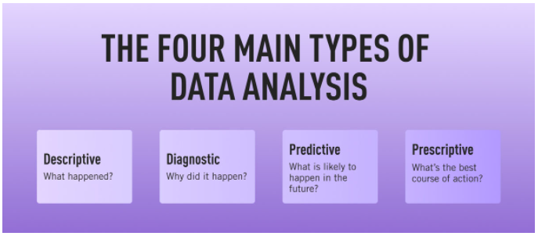
Types of Data Analytics
a) Descriptive analytics
b) Diagnostic analytics
c) Predictive analytics
d) Prescriptive analytics

Slide 5
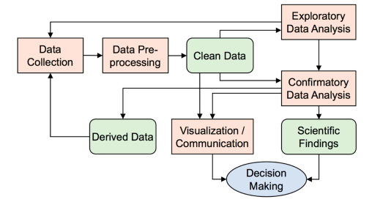
Process of Data Analysis

Slide 6

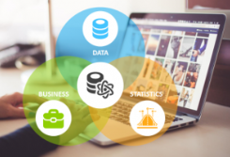
Role of Data Analyst
Duties of Data analyst.
Qualities expected in a Data Analyst role.
Skills required for Data Analyst.

Slide 7
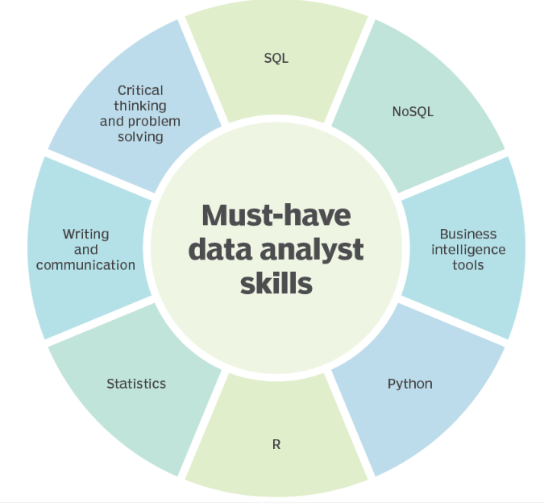

Slide 8


